Slide 1
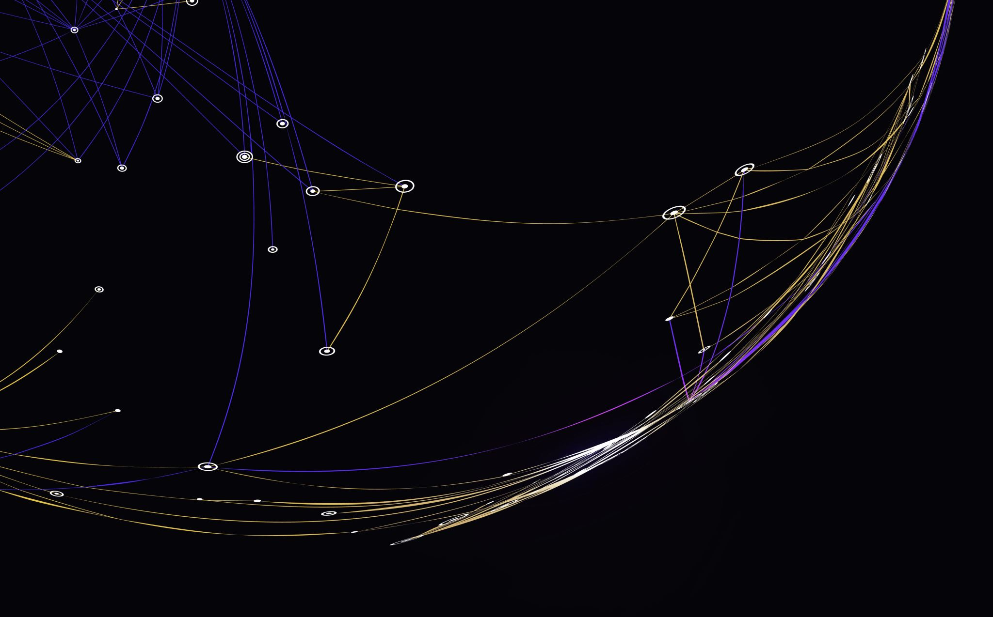
Classification using convex optimization
Mohammed said

Slide 2


Introduction
This project tries to classify object based on distance between real-time frame and 3d map of certain objects (will be discussed later).
This problem can be applied in various situations for instance objects at supermarket or car-plates etc.…

Slide 3
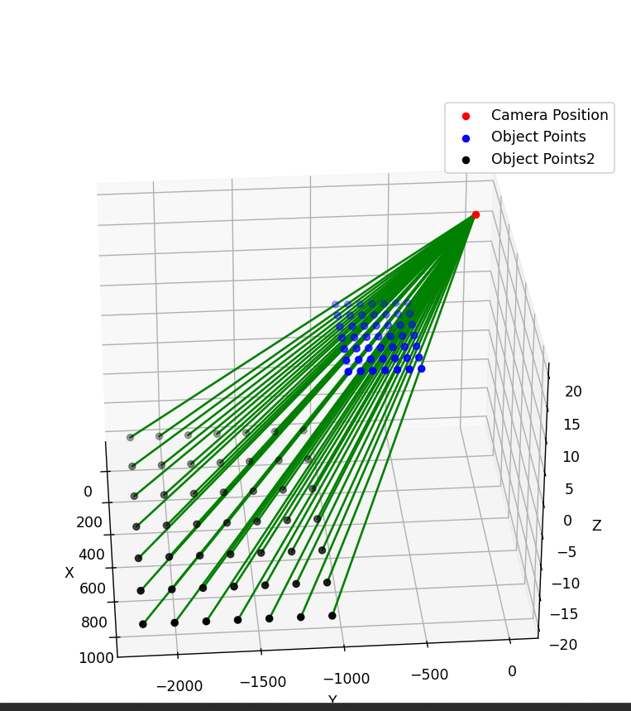
Chess board Prototype
As presented in the image we created 3d points (black) and plotted the key-points from a chessboard frame lines align perfectly when plotting lines from camera to 3d points that pass through image

Slide 4
Motive
We can classify much better than machine/deep learning algorithms in various ways:
Faster (run time and no need for long hours of training)
Better space (we don’t huf)
More accurate (since neural networks often suffer from similar objects)
Adaptive to different object if maps are swapped

Slide 5
3d Objects Classification
Starting with creating a 3d map of each objects from key-points detected using any type of structure of motion building application.
Find best match using descriptors by minimizing distance between matching descriptors.
For matches in certain range (minimization problem so small values) apply another layer of classification using distance from frame key-points to 3d key-points.
Return the best value (many ways can be used)

Slide 6
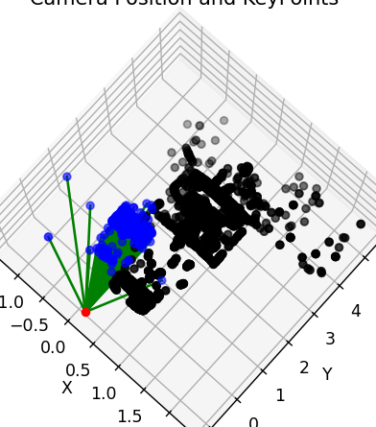
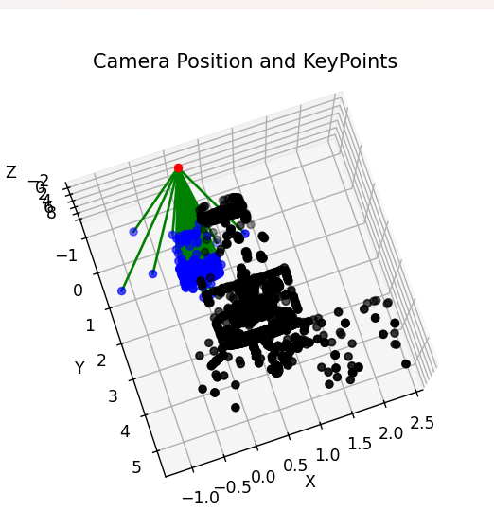
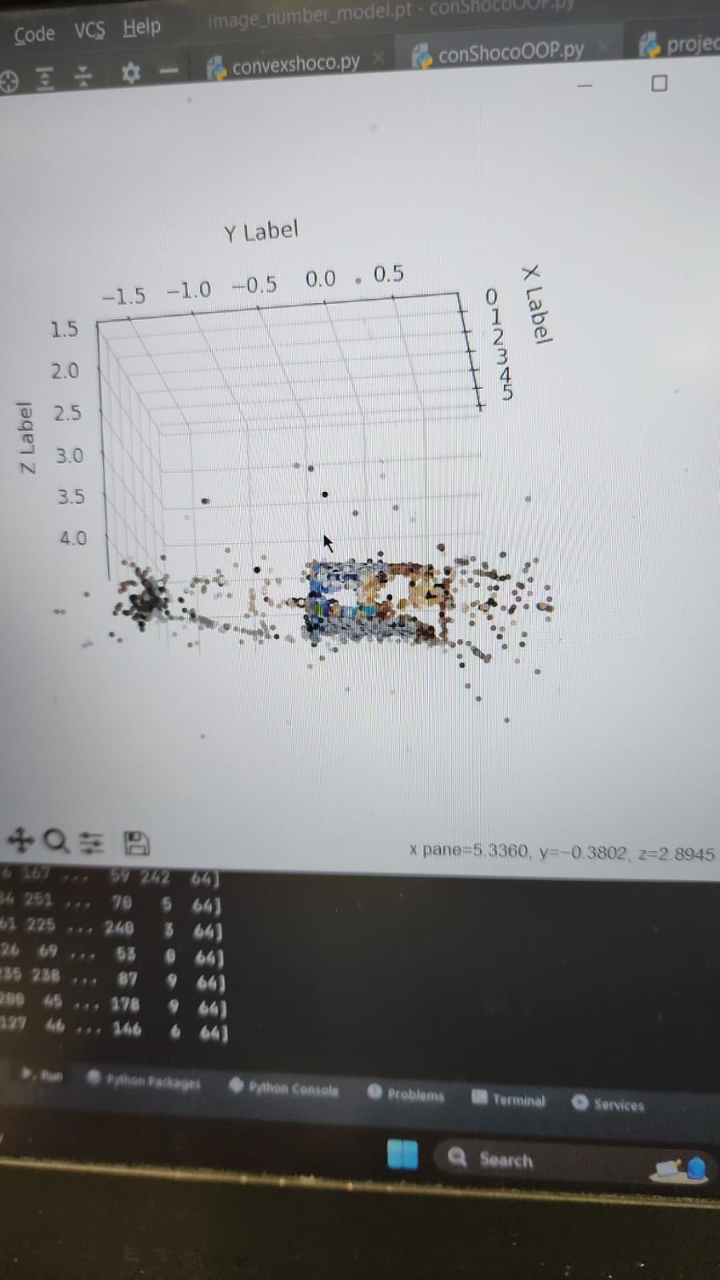
3D Vs Frame
as presented in frames ,structure detected in frame and map are quite similar although we might have some noise

Slide 7
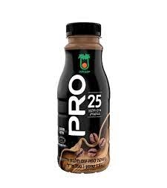
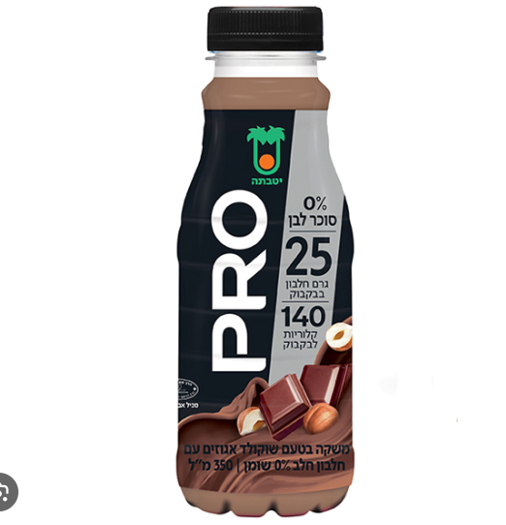
Run examples
frames:
We will try to classify each of these
frames to the most suitable map and as we can see
Difference between both frames isn’t huge

Slide 8
